Slide 1
SEP Week 3:
Architecture & Tech Stacks
Daniel Schien

Slide 2
Overview
System Architecture
  Motivations for a formalization
  Examples
Modelling
  Modelling systems at different levels
  Static Modeling
  Dynamic Modelling
Tech Stacks
  The technology which implements the system architecture
  Examples from previous SEP projects
  Choosing a tech stack
Open Source & Software Licenses

Slide 3
Software Architecture – What
Software architecture is a set of structures needed to reason about a system. It includes software components, the relations between them and properties of both.
Architecture might be implicit
  If you’re building any significant system. You cannot not have an architecture. You might just not been have documented or communicated explicitly.

Slide 4
Software Architecture – Why
Enables the engineering or large systems
  As systems grow it becomes unattainable to manage infrastructure without a well documented design
Communication of Ideas
  Between Developers
  To non-technical stakeholders
The role of a Systems Architect

Slide 5
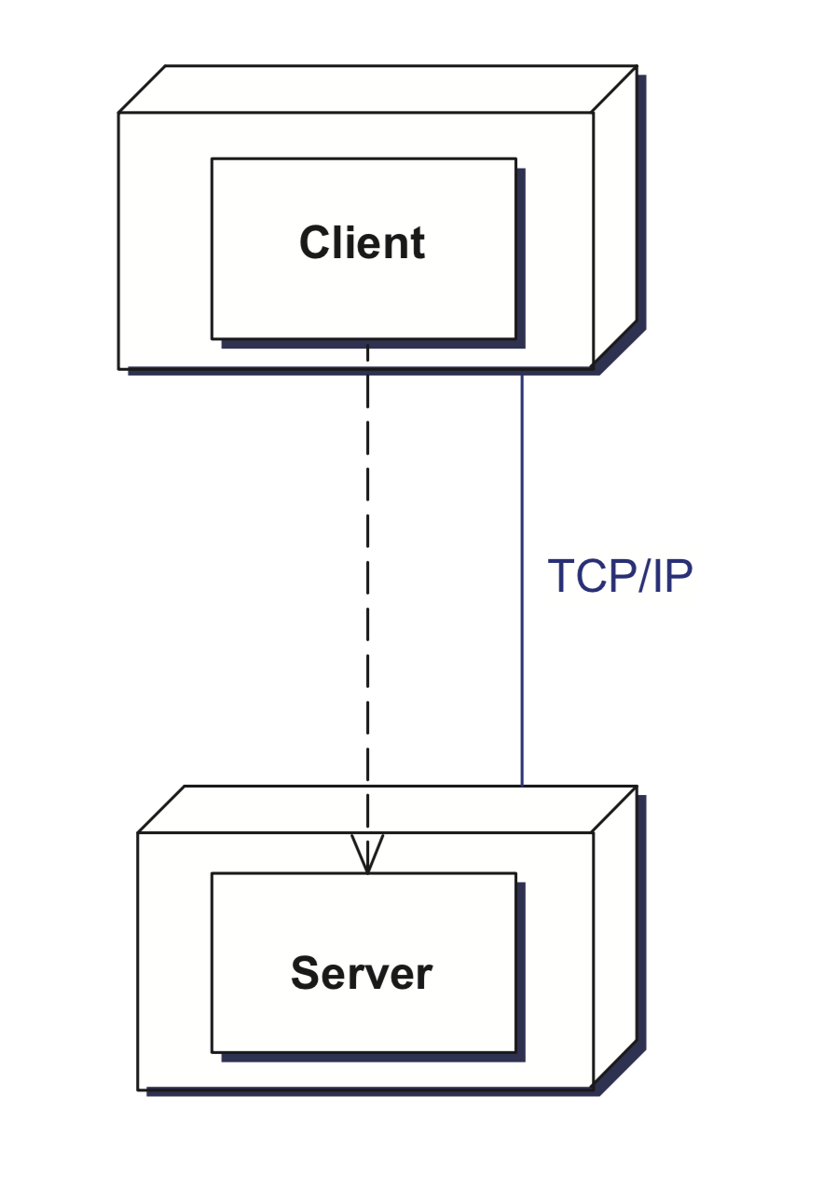
Example 1: Client-Server
clients requests services
Servers are permanently listening
Inter-process communication causes overhead
Requests and result data often have to be transformed or marshalled
sessions: stateless or stateful server

Slide 6
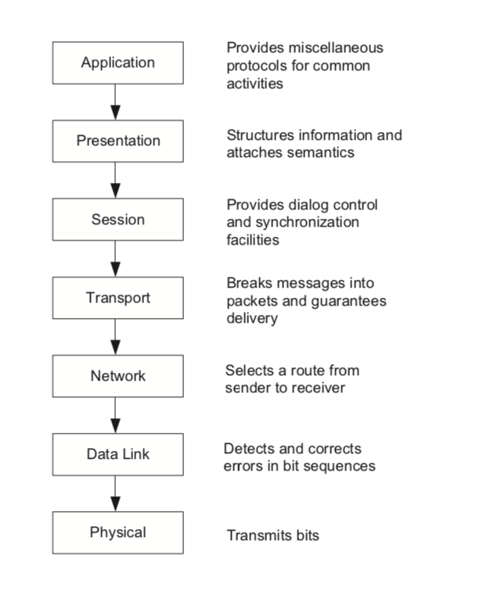
Example 2:
Layered Architecture
lower layer can be used by different higher layers
standardization
Dependencies are kept local
a change of the behaviour of a lower layer has an effect on the layers above it
defining an abstract service inter- face is not an easy job
lower layers may perform unnecessary work, not required by the higher layer.

Slide 7
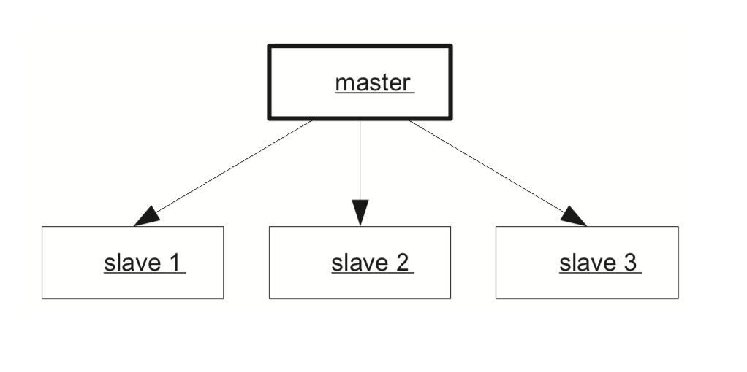
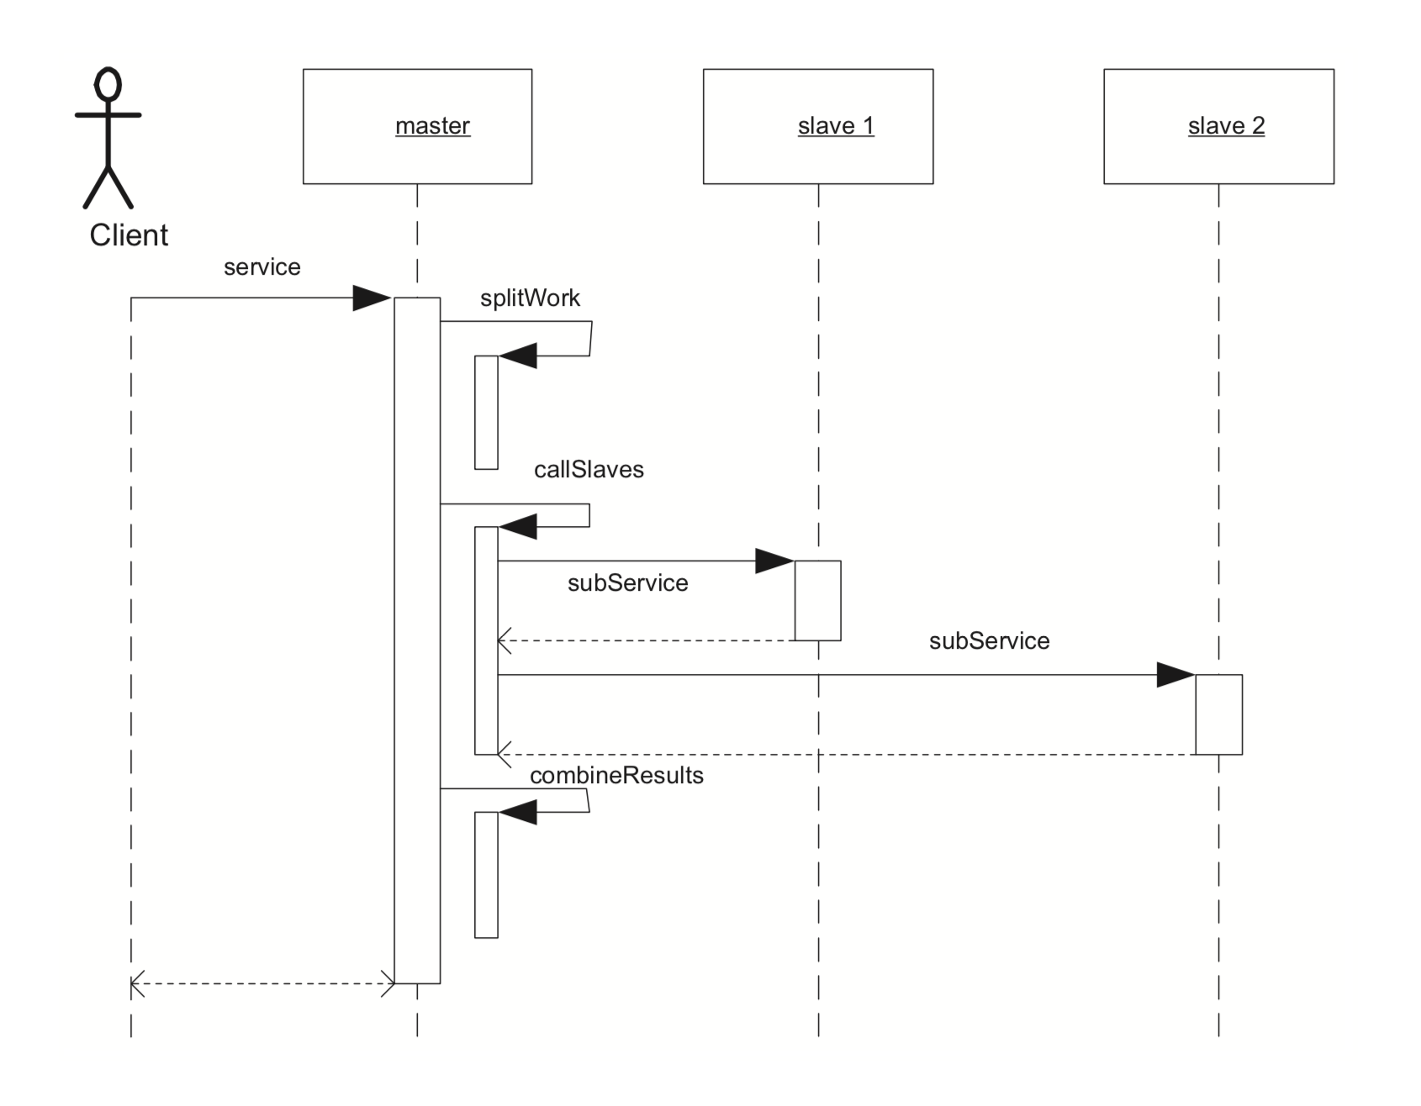
Example 3:
Controller / Worker
controller
worker
worker
worker
divide-and-conquer
Parallelisation, Fault Tolerance
Most cloud infrastructure frameworks
  Kubernetes, Hadoop, Spark
Computer Systems A
High Performance Computing
controller
worker
worker

Slide 8
Software Modelling

Slide 9
Just Enough Modelling
Big Design Upfront
  "Many times, thinking things out in advance saved us serious development headaches later on. ... [on making a particular specification change] ... Making this change in the spec took an hour or two. If we had made this change in code, it would have added weeks to the schedule. I can’t tell you how strongly I believe in Big Design Up Front, which the proponents of Extreme Programming consider anathema. I have consistently saved time and made better products by using BDUF and I’m proud to use it, no matter what the XP fanatics claim. They’re just wrong on this point and I can’t be any clearer than that.”
  Joel Spolsky, Stackoverflow and Trello
Be Pragmatic: Design where it provides value
  Break down complexity
  Enable shared understanding
  Driven by risk: how much would it hurt if you got it wrong?
Notes:
Criticism
requirements from users need refinement
needs of the business evolve
Software is hard – needs implementation

Slide 10
Analysis and Design Modelling
Analysis
  Domain Modelling
    Identify objects in the problem domain, relationships
Design
  Architecture
  Static properties
  Dynamic properties
Notes:
Domain modelling
The real world
• A shipping management system ---> how the shipping business works
• A todo application --> how todos are manipulated
• For technical systems, system may be its own domain model

Slide 11
Identifying Domain Entities
Not mechanical
Discussion Stakeholders
Things to look out for
  Objects
  Business process
  Job titles /roles
  Sets, grouping, containers, elements
  Events
  Record of work
Notes:
Tangible or physical object -- Aeroplane, Film
Transaction -- Sale, Payment, Reservation
Role -- Employee, Cashier, Pilot
Container of other things -- Store, Aeroplane
Thing in a container -- Item, Passenger
Existing system -- Air Traffic Control, Authentication System
Event -- Sale, Payment, Meeting, Landing
Record of finance, work or contract -- Receipt, Employment Contract, Maintenance Log

Slide 12
Entity associations
Describe relationships
Look out for
  Part of
  Description for
  Set member
  Uses/manages
  Communicates with
  Owned by
  Event
Notes:
Helps us identify functions

Slide 13
Associations
Can be named
  Association name
  Role names
Can include multiplicity
There can be more than one between two entities
They can be recursive
Notes:
Library
Member borrows book
Book is being borrowed

Slide 14
Grammatical Parse
Identify nouns from existing text
Narrow down to remove
  Duplicated variations
  Irrelevant
  Out of scope

Slide 15
Example
“Cloud computing is an information technology (IT) paradigm, a model for enabling ubiquitous access to shared pools of configurable resources (such as computer networks, servers, storage, applications and services),[1][2] which can be rapidly provisioned with minimal management effort, often over the Internet.”
https://en.wikipedia.org/wiki/Cloud_computing

Slide 16
Example
“Cloud computing is an information technology (IT) paradigm, a model for enabling ubiquitous access to shared pools of configurable resources (such as computer networks, servers, storage, applications and services),[1][2] which can be rapidly provisioned with minimal management effort, often over the Internet.”
https://en.wikipedia.org/wiki/Cloud_computing

Slide 17
Task 1: Grammatically Analyse Your Project Brief
As a team, read your project brief again. Parse the text to understand the objects involved.
Look out for objects and their associations and write them down
If the client has not included enough detail, then write your own brief which describes the objects and associations which might be involved
5-10 Minutes

Slide 18
Static Design Models

Slide 19
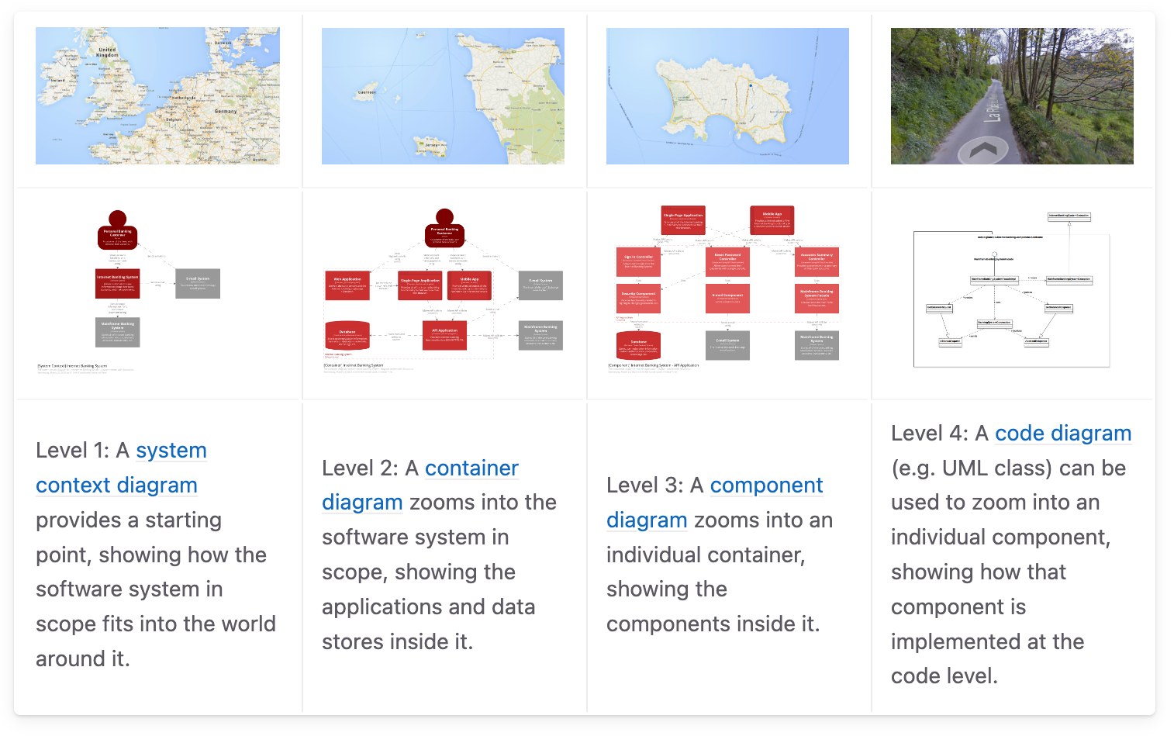
C4 model for visualising software architecture
https://c4model.com/introduction
Sequence of set choices of level of abstraction

Slide 20
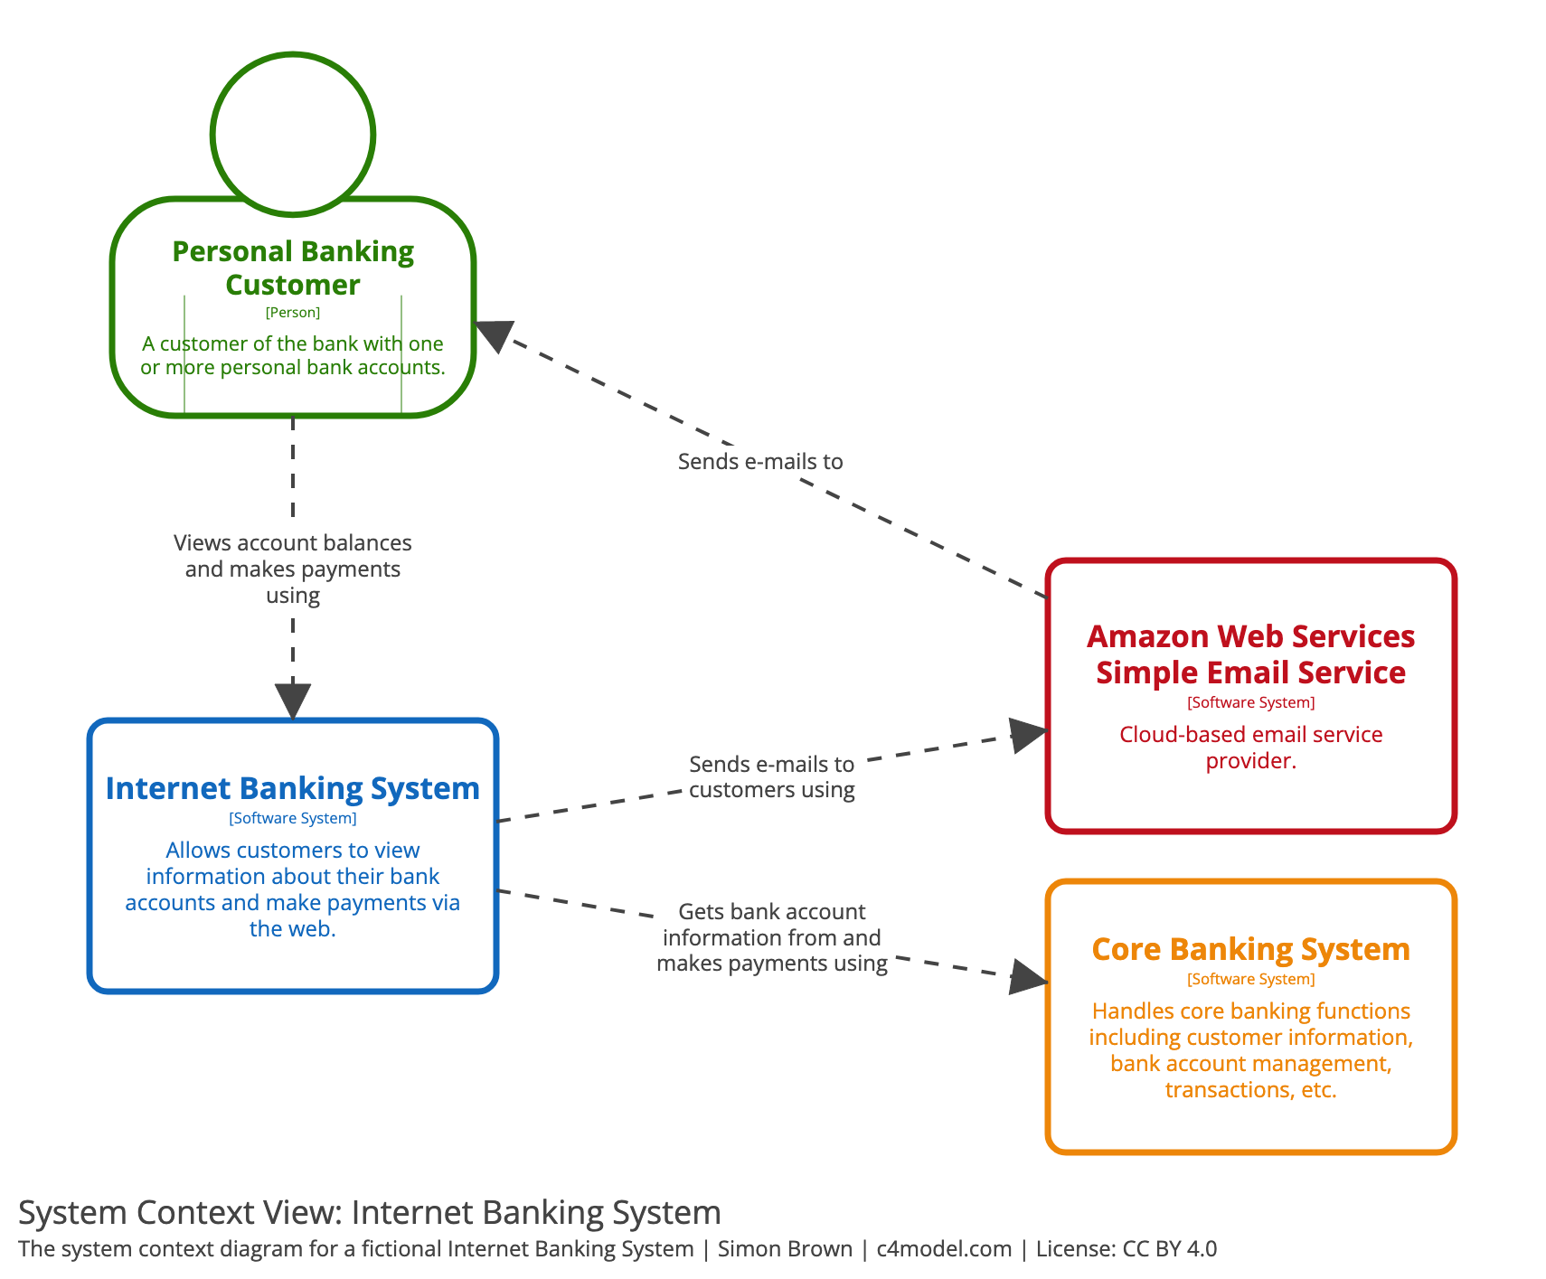
C4 model - Level 1:
System Context
Intended to be used by technical and non-technical people
  Useful for communicating the system back to the client

Slide 21
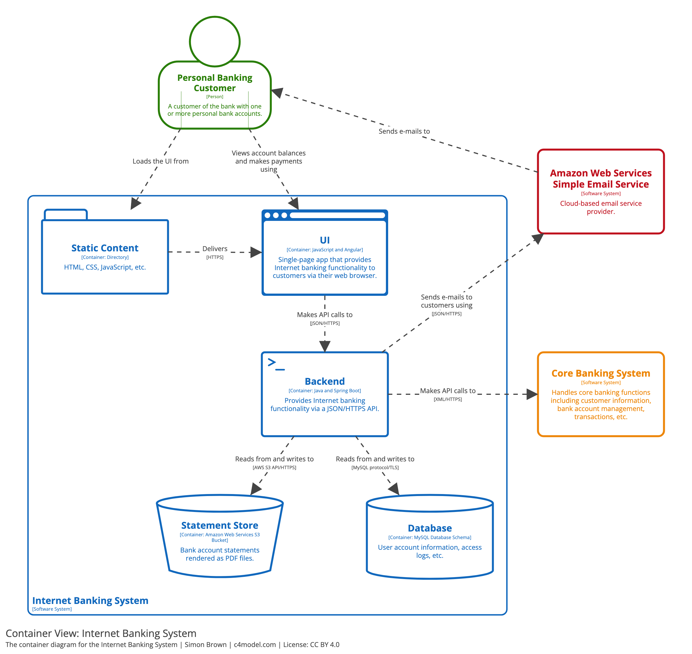
C4 model - Level 2: Container Diagram
Intended for Technical people inside and outside the software development team; including software architects, developers and operations/support staff.

Slide 22
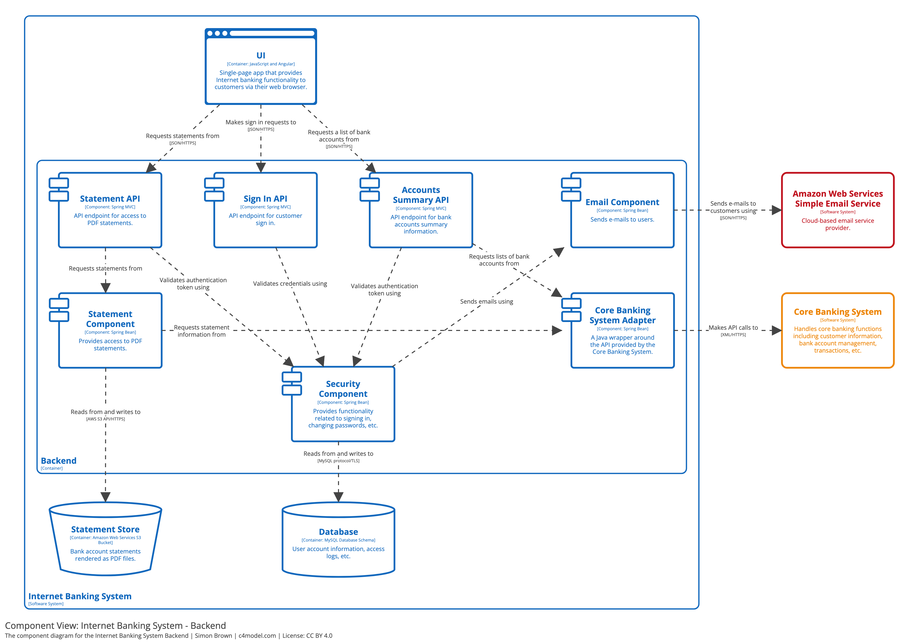
C4 model - Level 3:
Component Diagram
This could be:
  A single element of your cloud infrastructure
  The user application
Intended to be used by software architects and developers
Is it required?
  Not needed for every part of the system
  Recommended for more complex components
  Useful for documentation and handover

Slide 23
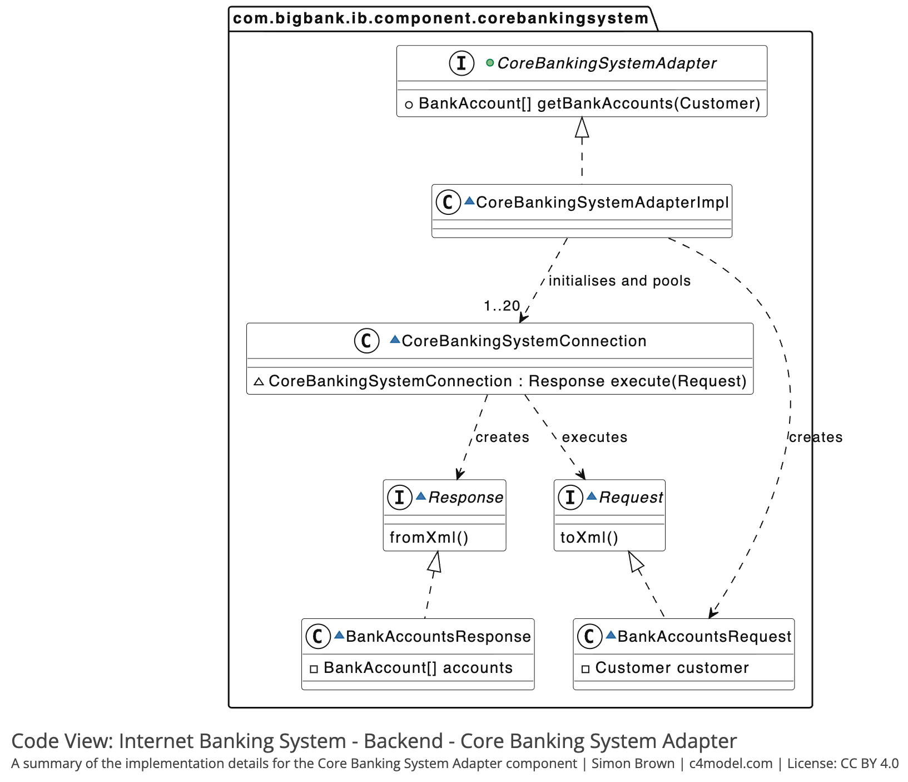
C4 model - Level 4:
Code Diagram
A single component of the system
Uses a formalized UML
Not always necessary
  Code structure can change frequently
  Smart IDEs can generate this automatically

Slide 24
Task 2: Create a system context diagram
Visit the C4 website for more info: https://c4model.com/introduction
As a team, create a system context diagram
Keep it high level!
Take a picture of it afterwards so your don’t lose it!
~10-15 Minutes

Slide 25
Dynamic Design Models

Slide 26
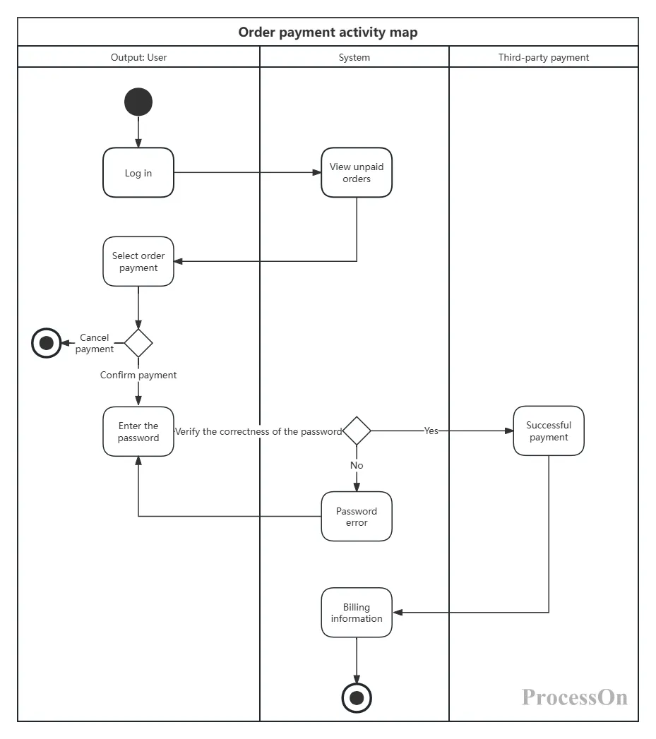
Activity Diagrams
Defines an application workflow from start to finish including:
  Starting and terminating points
  Actions
  Relations
  Branches
  Swimlanes

Slide 27
Sequence Diagram Example
Actor and Life line
Branch
Synch
Message
Loop

Slide 28
Task 3: Create a sequence diagram
Come up with scenarios of use for your project.
Create a sequence diagram for each scenario
~10 Minutes

Slide 29
Choosing a Tech Stacks

Slide 30
Tech Stack Example 1:
Web App
Languages: JavaScript/TypeScript, HTML, CSS
Back End: Node.js
Databases: MySQL, PostgreSQL, MongoDB, and others
Targeted Platform: Browser
Example Project: 2023-RoboSim
or
Languages: Java, JavaScript, HTML, CSS
Framework: Spring Boot with Thymeleaf
Databases: Works with SQL or NoSQL databases
Targeted Platform: Browser
Example Project: 2023-CityFarm

Slide 31
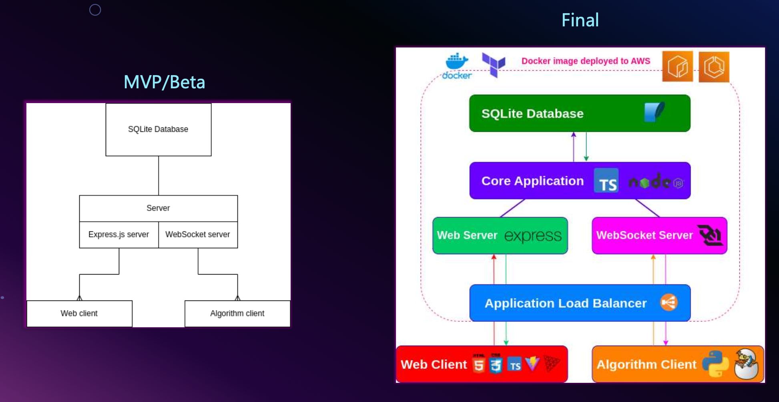
Tech Stack Example 1:
Web App – 2024-RoboSim

Slide 32
Tech Stack Example 2:
Cross-Platform / Mobile Applications
Languages: Dart
Framework: Flutter
Databases: PostgreSQL
Example Project: 2023-MarineConservationApp

Slide 33
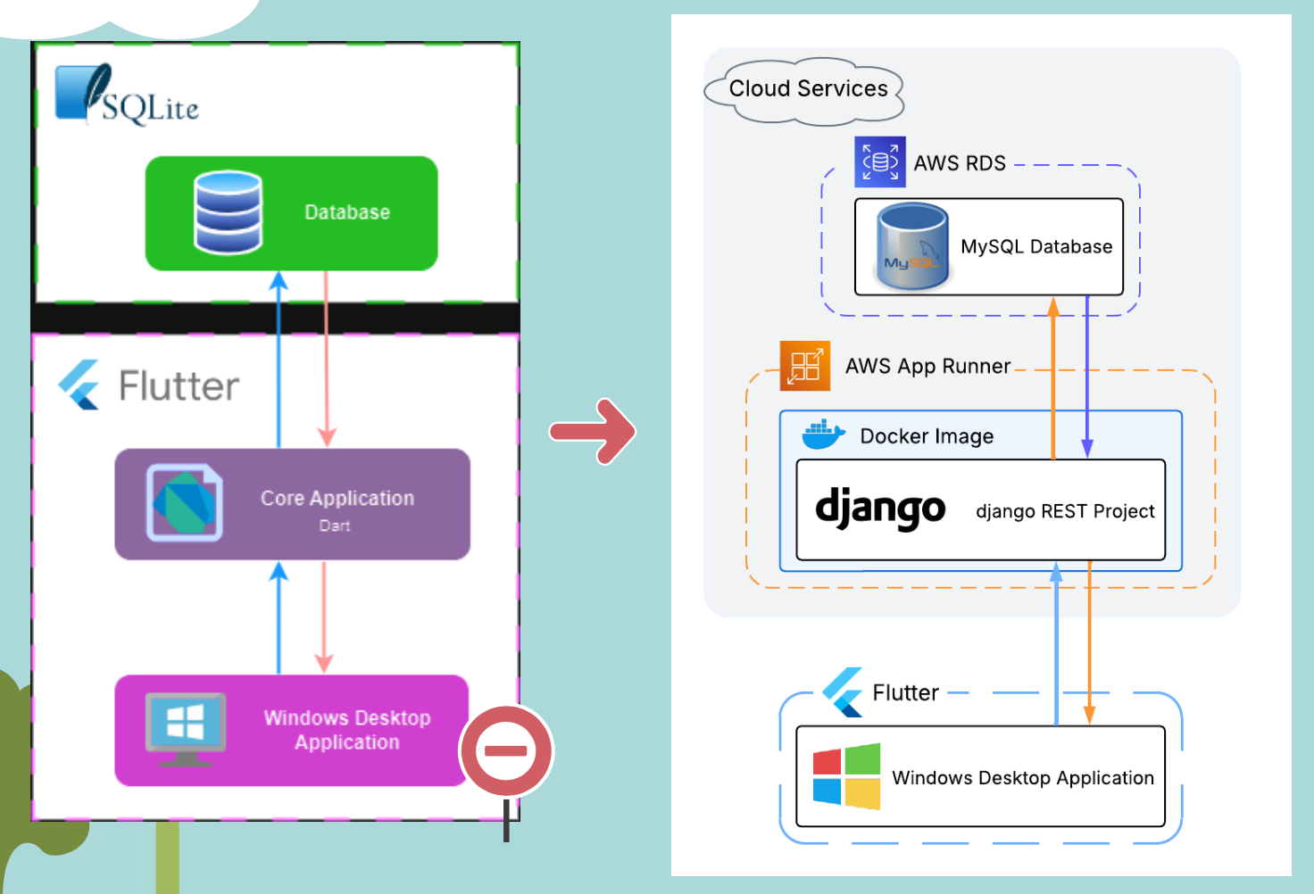
Tech Stack Example 2:
Cross-Platform / Mobile Applications
2024-SprintCommunityTransport

Slide 34
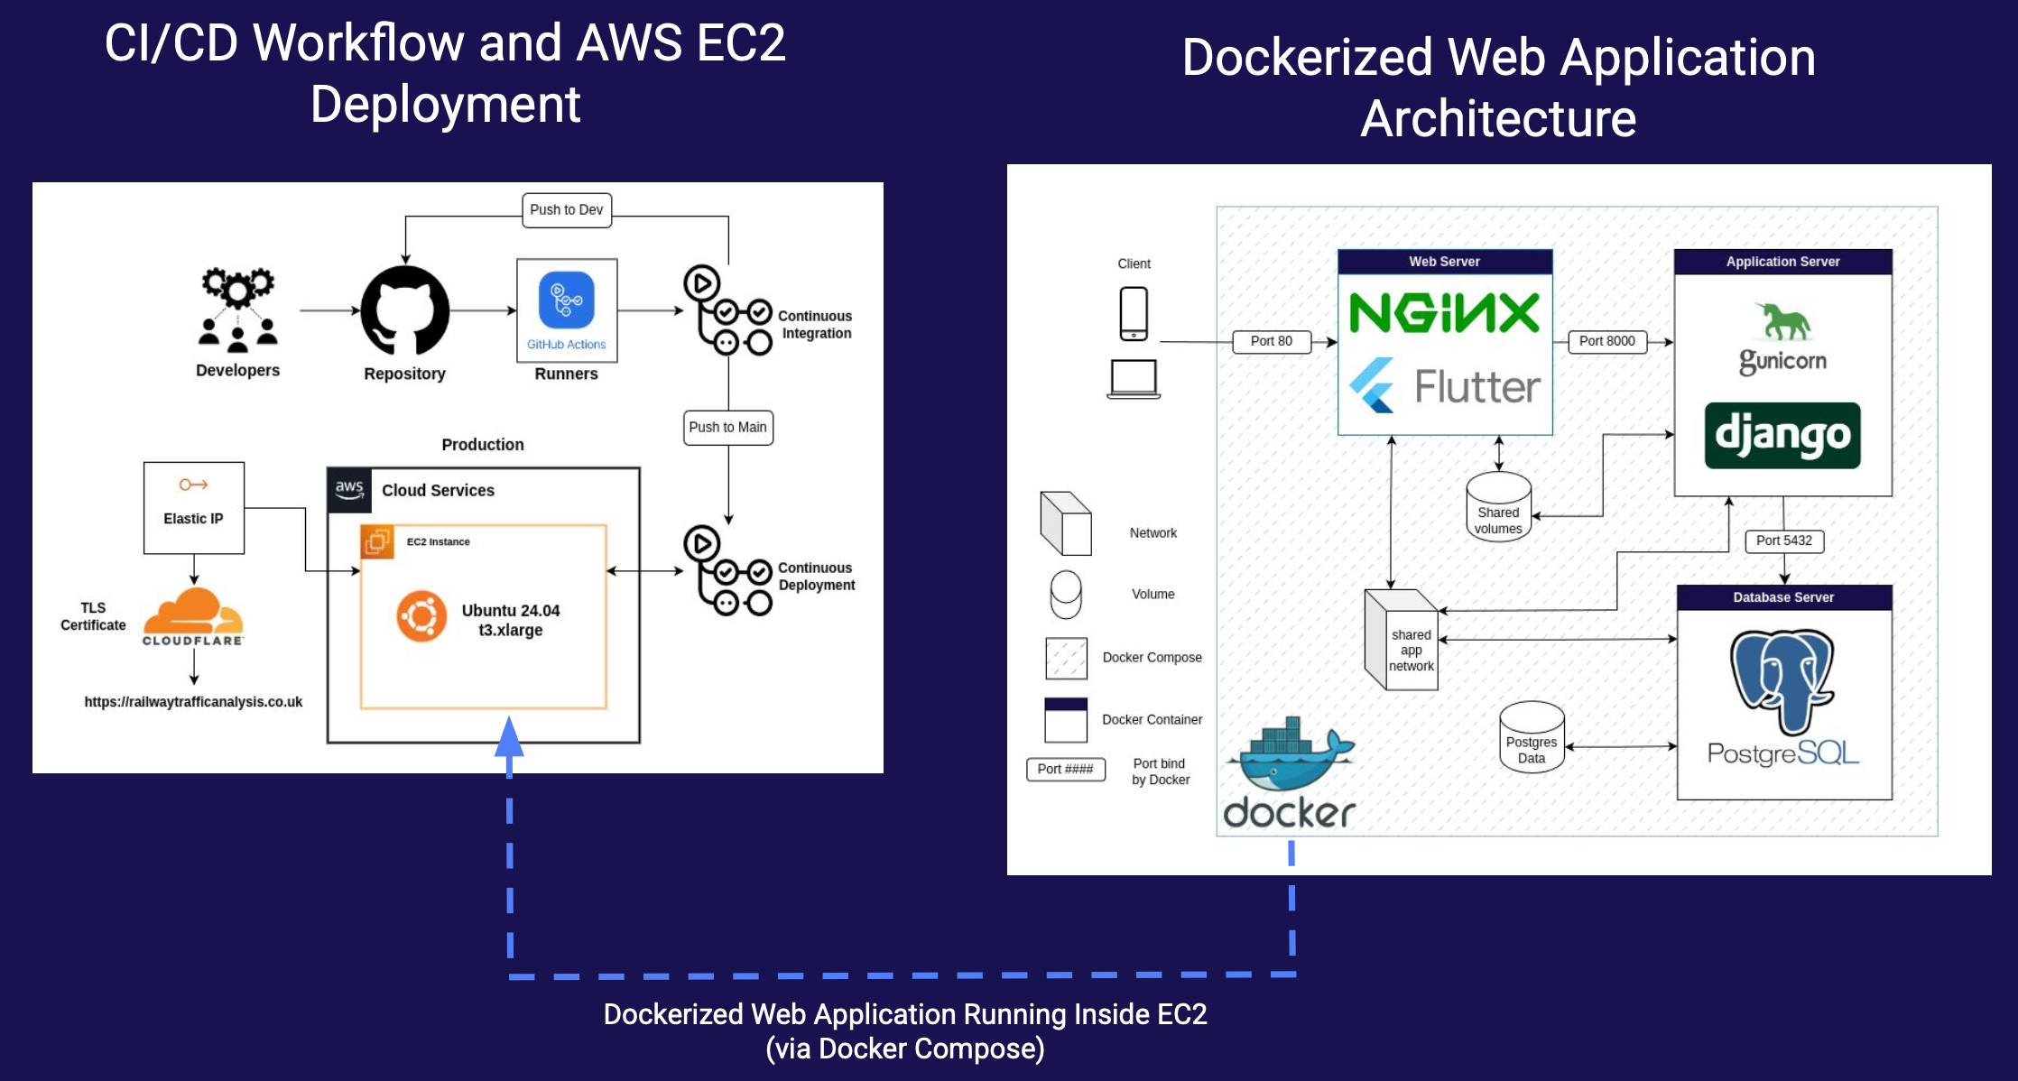
Tech Stack Example 2:
Cross-Platform / Mobile Applications
2024-RailwayTrafficAnalysis

Slide 35
Tech Stack Example 3:
Games & 3D Environments
Languages: C#
Framework: Unity
Databases: C# libraries can connect to a variety of SQL or no-SQL databases.
Targeted Platforms: Windows, Linux, macOS, iOS, Andriod and others.
Example Projects: 2023-Edutopia & 2023-SkillsLearningGame (This has some interesting design documents in their 'docs' folders that you might want to take inspiration from.)

Slide 36
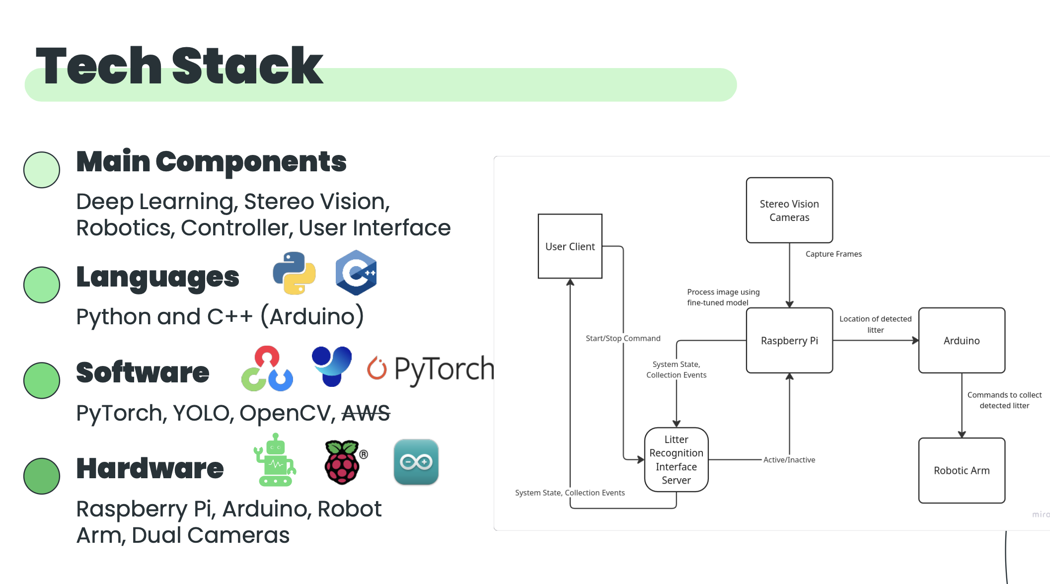
Tech Stack Example 4:
Hardware Based Project
2024-LitterRecognition2

Slide 37
Middleware
Software which connects different components or applications
Sits between applications and infrastructure to simplify the handling of services such as:
  Databases – e.g. JDBC
  API Management – e.g. Nginx
  Message Passing - e.g. Kafka
Decouples components to increase scalability

Slide 38
Tech Stacks are not Static!
Tech Stacks can:
  Change
  Evolve
  Mature
  Be rewritten

Slide 39
Task 3: Technology Choice Matrix
Tech Stack Fill in the matrix with evidence. Present to your client with advantages / disadvantages of each stack. | Description Where deployed? Vendor? Open Source? Maturity? Popularity? | Fit to Project What requirements drive this choice? | Experience in Team Have you worked with these technologies before? How high is the learning curve? Is there a champion who will support others? Where will you get help? | Maintenance How will the client maintain the system built with these tech.? | Risks Cost? Security/ software updates? Will the technologies interact well?
A
B
C

Slide 40
Task 4: Create a Container Diagram
Using the C4 model, zoom into one of you main components identified in tasks 1 & 2 and create a container diagram with the tech stack which most likely to be used
20 Minutes?

Slide 41
How to organise your team
We DON’T recommend splitting up into a FrontEnd and BackEnd team, or similar
While it’s good to start out with specific tasks and roles, having static sub-teams is bad for SEP

Slide 42
How to organise your team
You will all need to review each others' code - separation makes this much harder.
You will be completing work at a different pace – leading to mismatched bursts
You will need to be integrating the work at some point
Resilience: If a team member leaves, your project shouldn’t break
Flexibility is better for your goals – in SEP and elsewhere

Slide 43
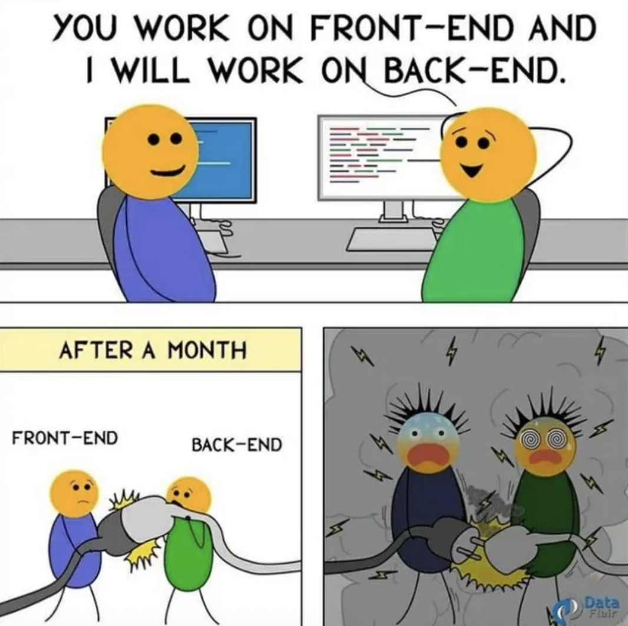

Slide 44
How to organise your team
DO NOT organise sub-teams around nationality/language!
You are at an international University, preparing for careers with international companies – employers will expect you to be able to work with people from different backgrounds/nationalities/languages
Rotating roles is a marks magnet!

Slide 45
Open Source & Licenses

Slide 46
Software Licenses
Licenses are not Patents!
Copyright Laws
Modification
Distribution
Usage – Commercial, Patent, Private
Liability – Can you be held responsible if something goes wrong?
Warranty – Will you help if something goes wrong?
Working within software communities
  i.e. a Wordpress Plugin must have a GNU GPLv2 license or later

Slide 47
Open Source Software
Improves collaboration & compatibility
Community Driven
Most SEP projects are Open Source
Comes with a legal responsibility to ensure other licenses are not broken
  Are you using any libraries in accordance with their license?
  What are the licenses restrictions of any images or resources?
Discuss with your client!

Slide 48
Task 5: Choose a License
Discuss as a group:
  Will the software be closed or open source?
  Which license will the project have - Choose-a-License
Push a LICENSE file to the root directory of your project
If intending to become open source: Explore the FOSSA tool
You might need to discuss this with your client at the next meeting!

Slide 49
Wrapping Up!
Independent Software Development Research
Expectations for SEP:
  Develop a software system of significant scale within a mature and repeatable Software Development process and apply Agile Principles & Practices.
  Select and employ development support tools (as appropriate to the project being undertaken).
Questions?

